Slide 1
Restaurant Management System
Star Spartans
Parth Marathe
Srushtee Upashi
Srushti Doshi
Aditi Shah

Slide 2
Introduction :
Database Architecture – OLTP
Features of the application
Data Warehouse Architecture
ETL Process
Dashboard

Slide 3
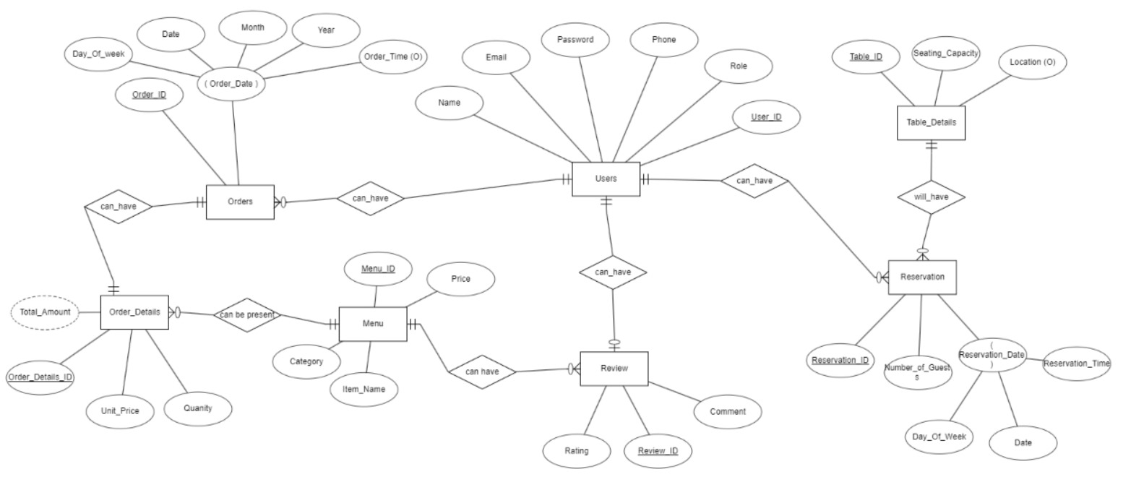
OLTP ER Diagram

Slide 4
OLTP Model Flow
Menu – ID, Item Names, Category, Price
User – ID, Name, Email, Phone, Role, Password
Review – Review ID, Rating, Comment
Order - ID, Date, Time, User ID
Order Details – ID, Menu items, Quantity, Unit Price, Order ID
Table Details – Table ID, Seating Capacity, Location
Reservation – ID, Date, DOW, No. of Guest, Time (User ID and Table ID)

Slide 5
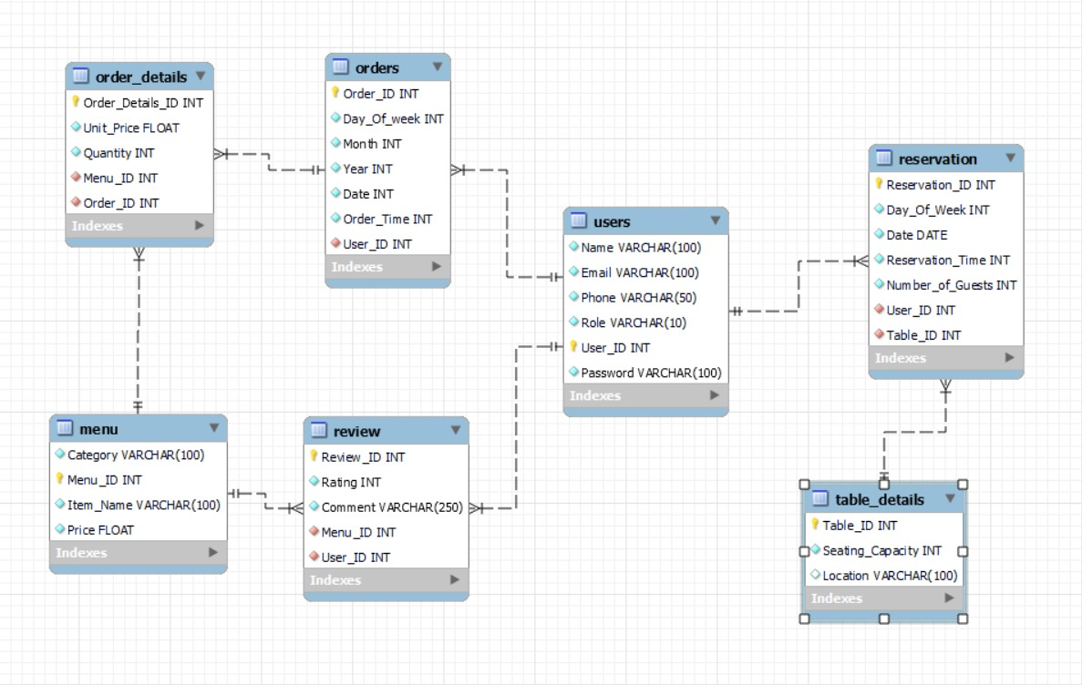
OLTP EER Diagram

Slide 6
Features of the Application (Customer)
Login/Register
Update Profile
Menu
Confirm Order
Reservations
Order History

Slide 7
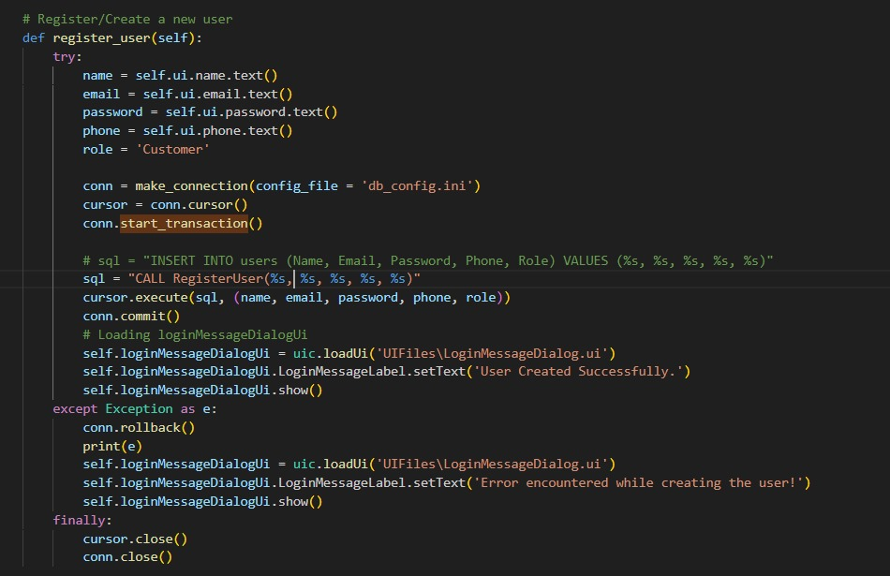
Register

Slide 8
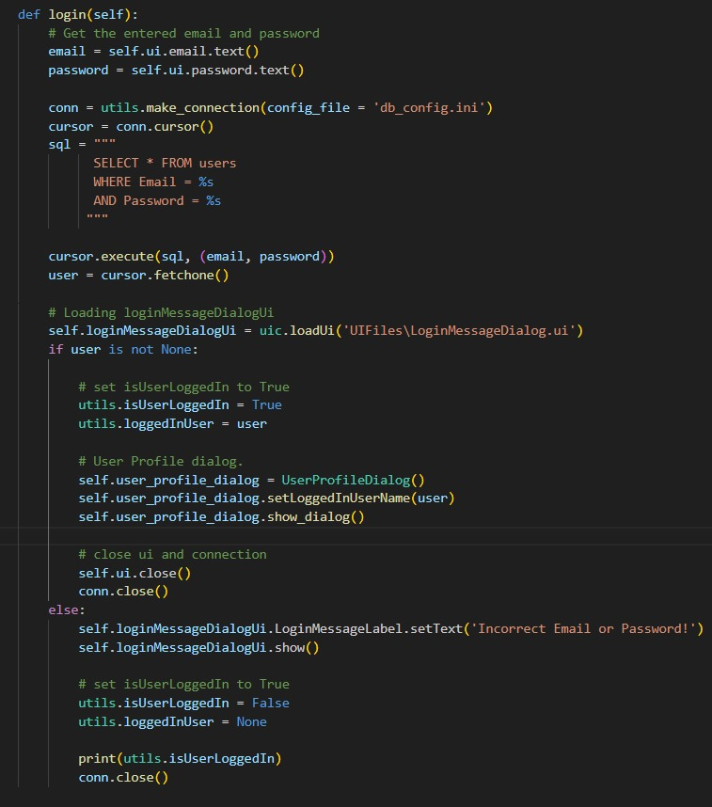
Login

Slide 9
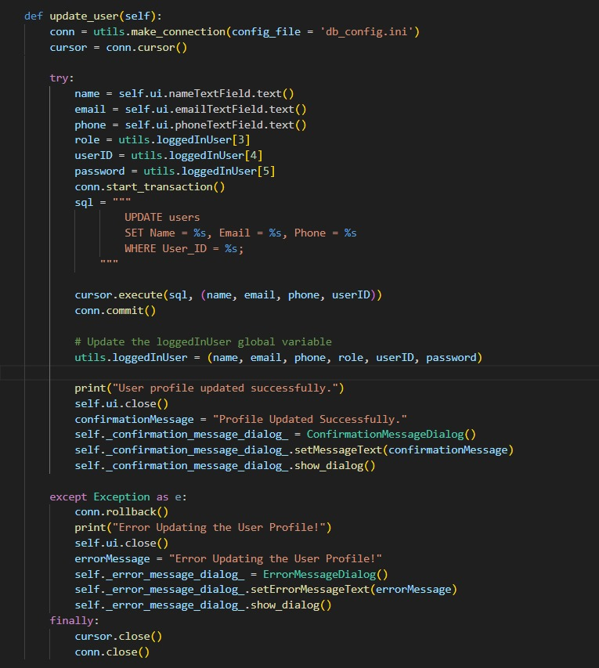
Update Profile

Slide 10
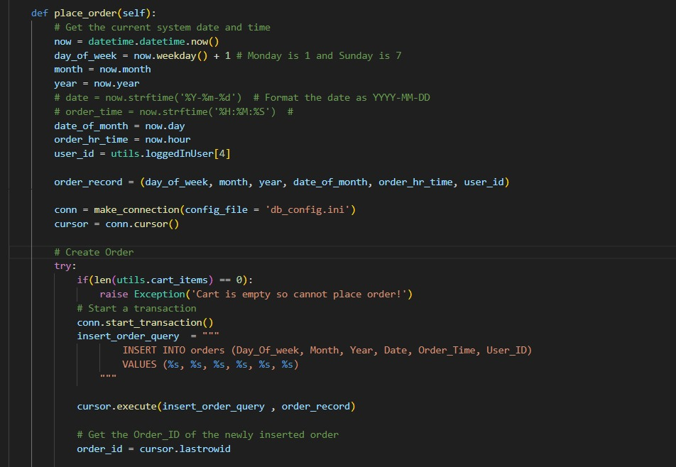
Confirm Order

Slide 11
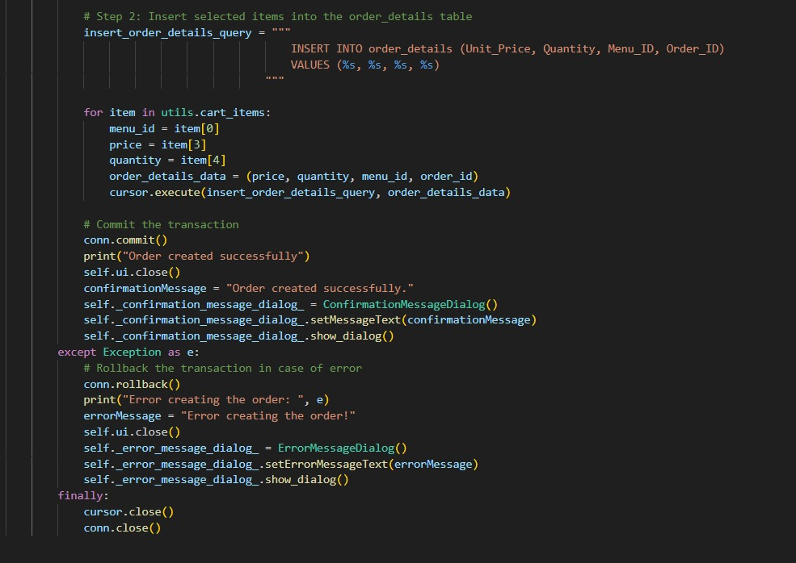
Confirm Order

Slide 12
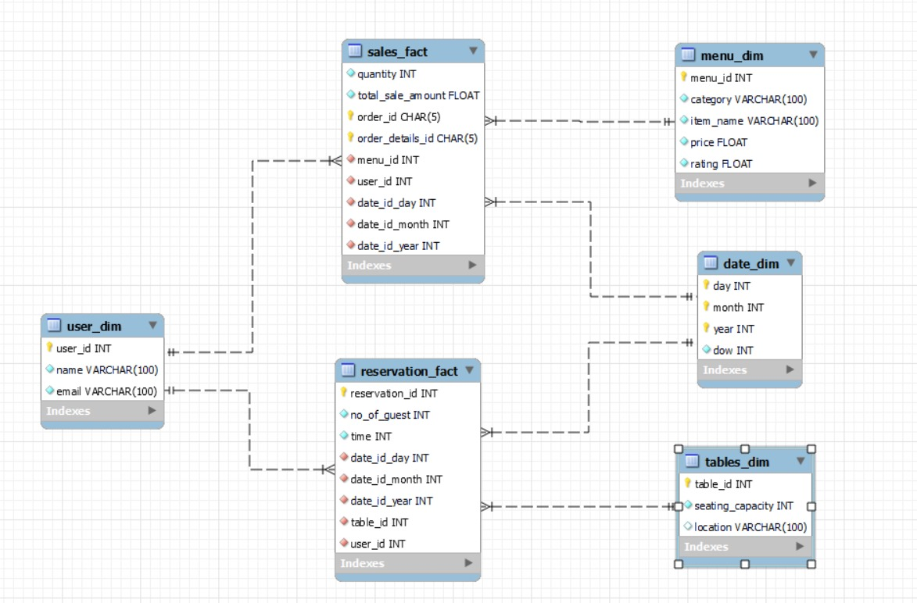
OLAP Architecture (Star Schema)

Slide 13
Dimensional Model
Fact Tables – Sales Fact, Reservation Fact
Dimension Table – Date Dim, User Dim, Menu Dim, Tables Dim
Date – Date, DOW
User – ID, Name, Email
Menu – ID, Menu Item, Category, Price, Rating
Tables – ID, Capacity, Location
Sales – Linked with Date, User, Menu and Total sales column
Reservation - Linked with Date, User, Table and Time, No. of Guest

Slide 14
ETL
We have performed ETL operations on the data of the OLTP database and transformed the data into a dimensional model to populate our OLAP database/warehouse.
Removing unnecessary columns.
Changing the Datatypes according to the requirements and modifying the lengths of the required columns.
Merging columns.

Slide 15
Features of the Application (Admin)
Login/Register
Update Profile
Menu
Order Cart
Reservations
Order History
Show Users
View All Reservations
View All Orders
Dashboard

Slide 16
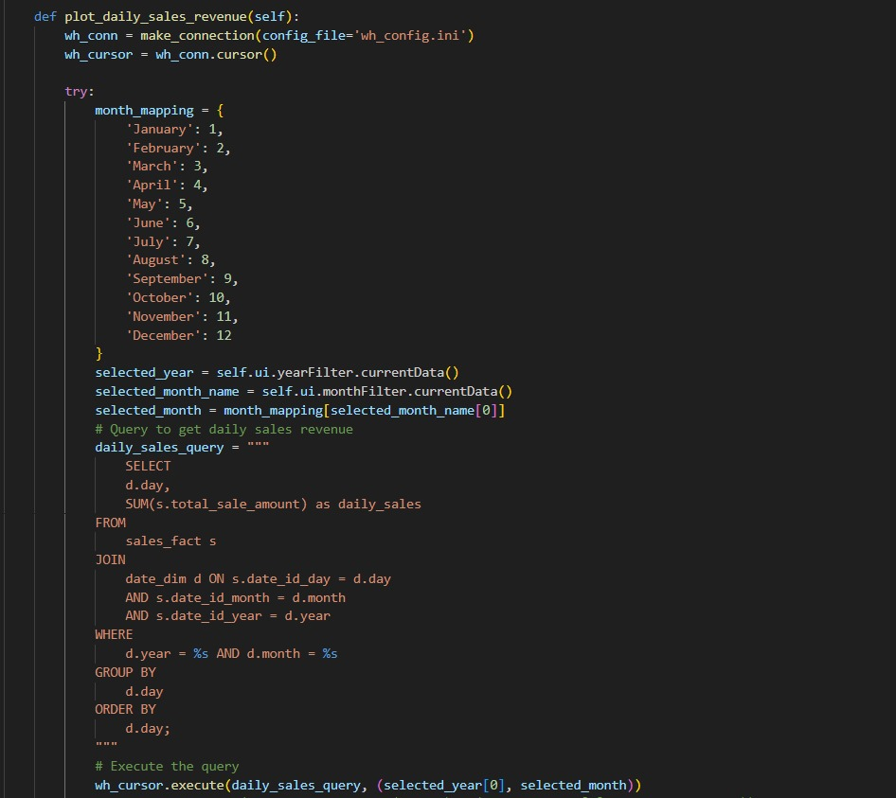
Dashboard

Slide 17
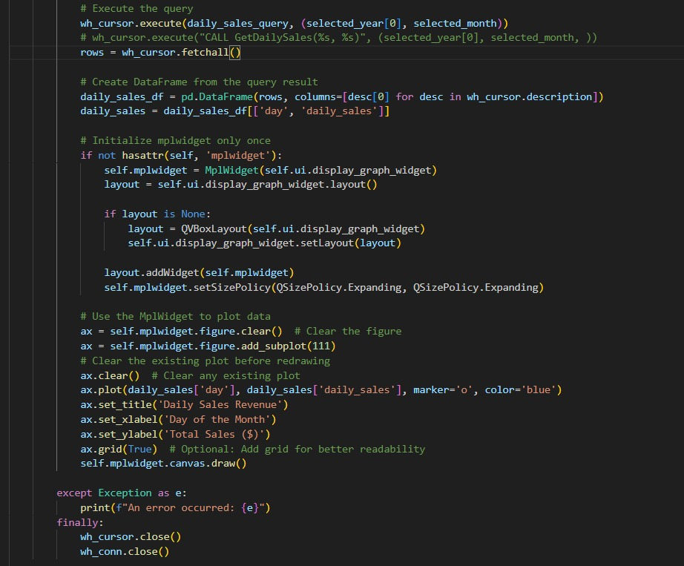
Dashboard

Slide 18
Please feel free to ask any questions.

Slide 19
Thank you!

